Slide 1
Process Flow
Login screen
Home screen Patient
Patient lookup
ESAS assessment
Track symptoms
Add new patient
Completed By
Pain
Tiredness
Drowsiness
Nausea
Lack of Appetite
Shortness of Breath
Depression
Wellbeing
Other Problem
Anxiety
Intensity trends
Total intensity
Select symptom
Select date
Home screen HC Professional
PRFS reports
ESAS reports
Recorded activity rating
Select date
PRFS assessment
Activities & Function
Leave a comment
Patient archive
Logout
Settings

Slide 2
Patient Process Flow
Login screen
Home screen Patient
ESAS assessment
Track symptoms
Completed By
Pain
Tiredness
Drowsiness
Nausea
Lack of Appetite
Shortness of Breath
Depression
Wellbeing
Other Problem
Anxiety
Intensity trends
Total intensity
Select symptom
Select date
PRFS reports
ESAS reports
Recorded activity rating
Select date
PRFS assessment
Activities & Function
Leave a comment

Slide 3
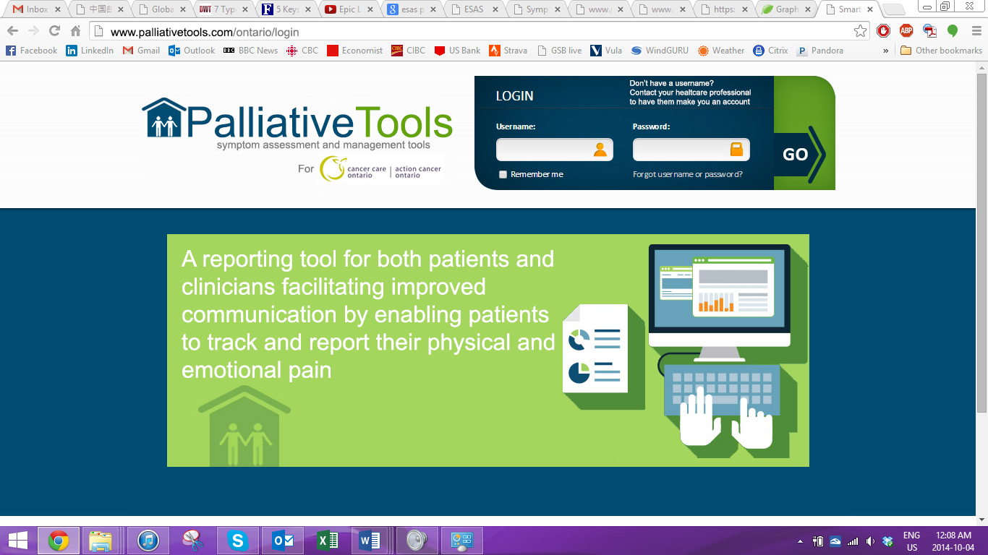

Slide 4
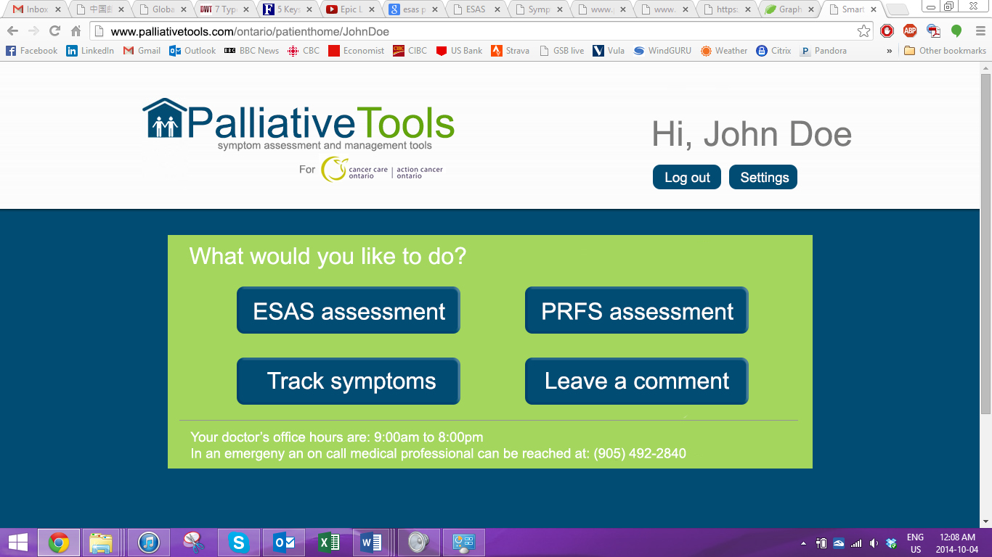

Slide 5
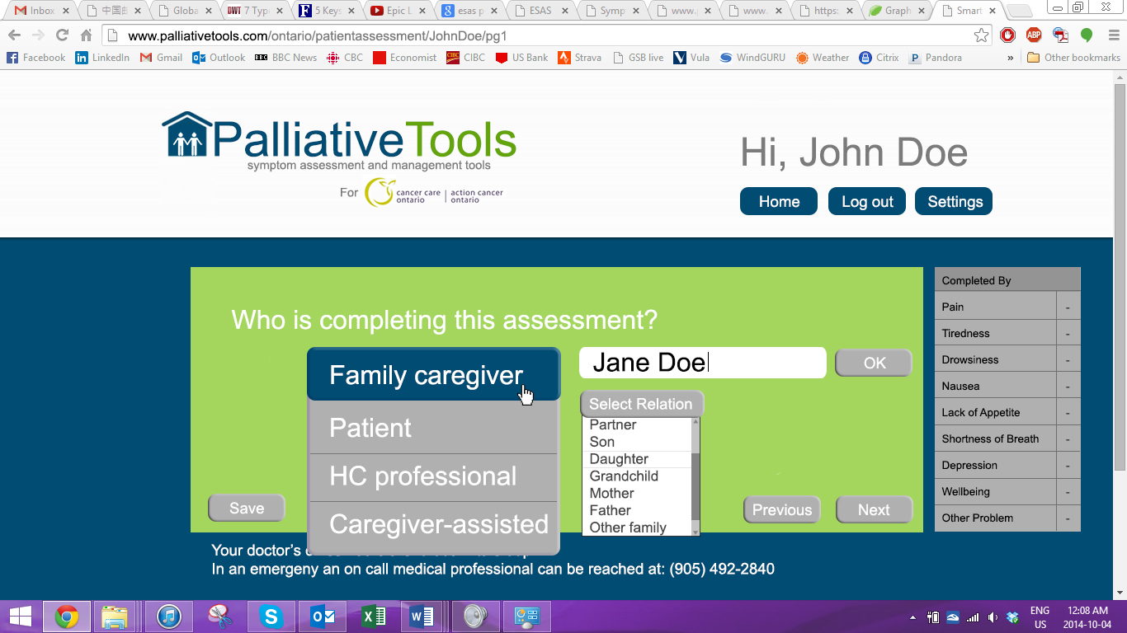

Slide 6
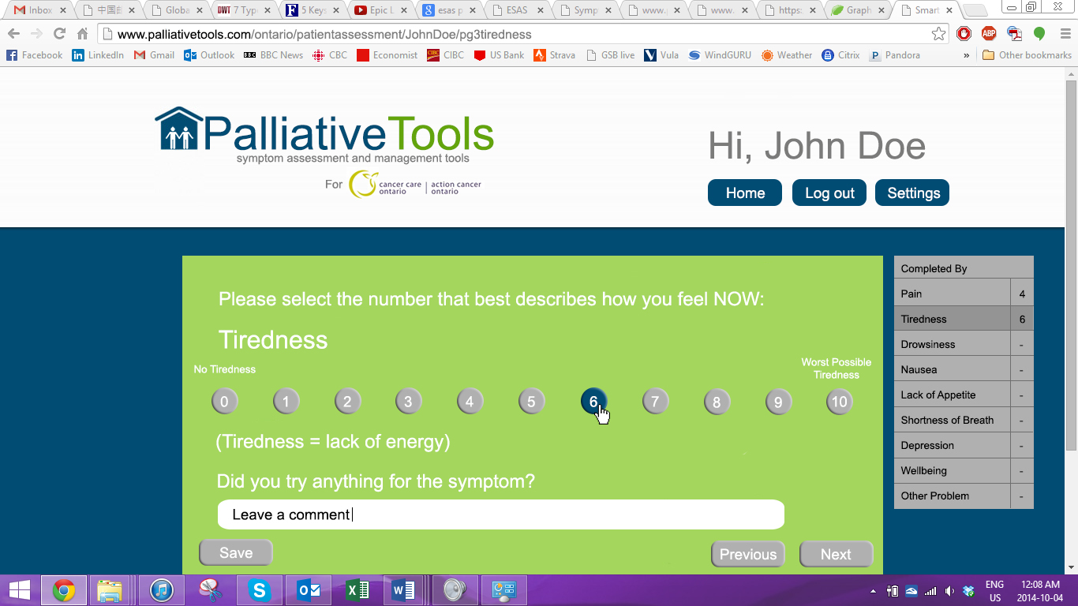

Slide 7
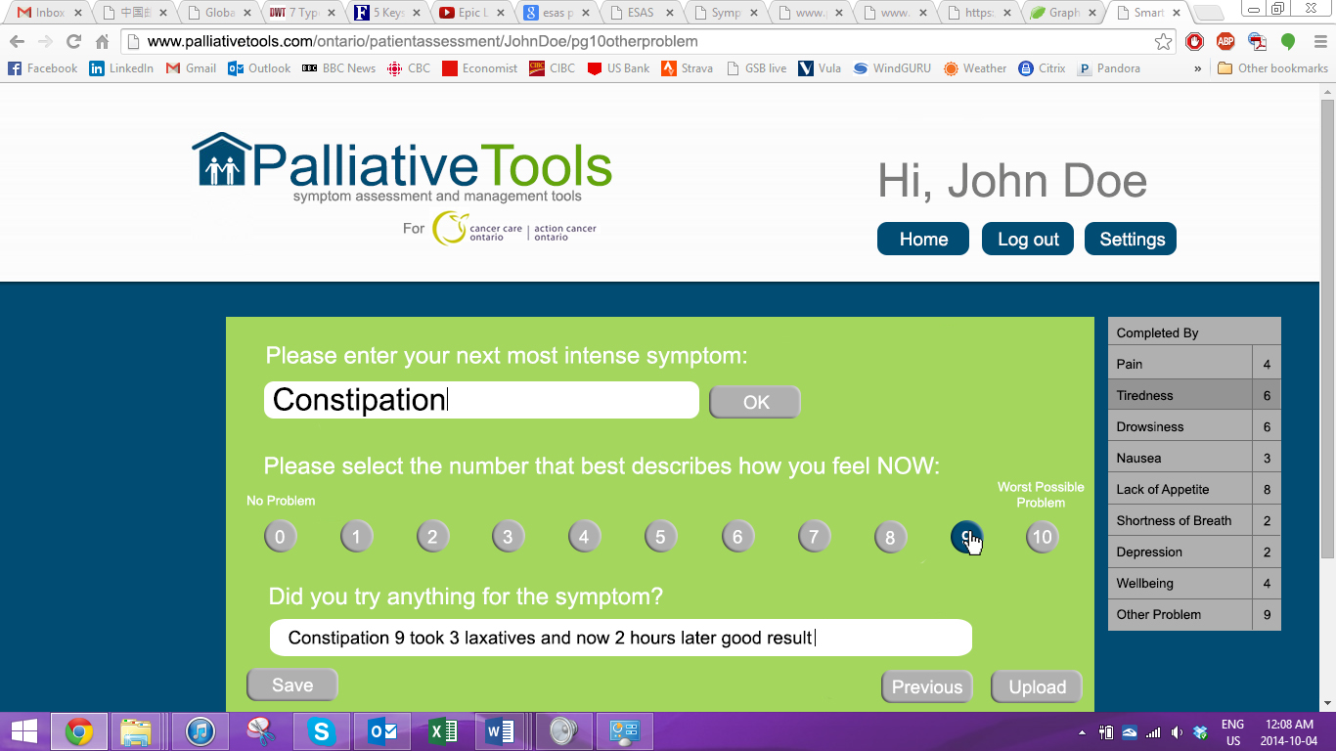

Slide 8
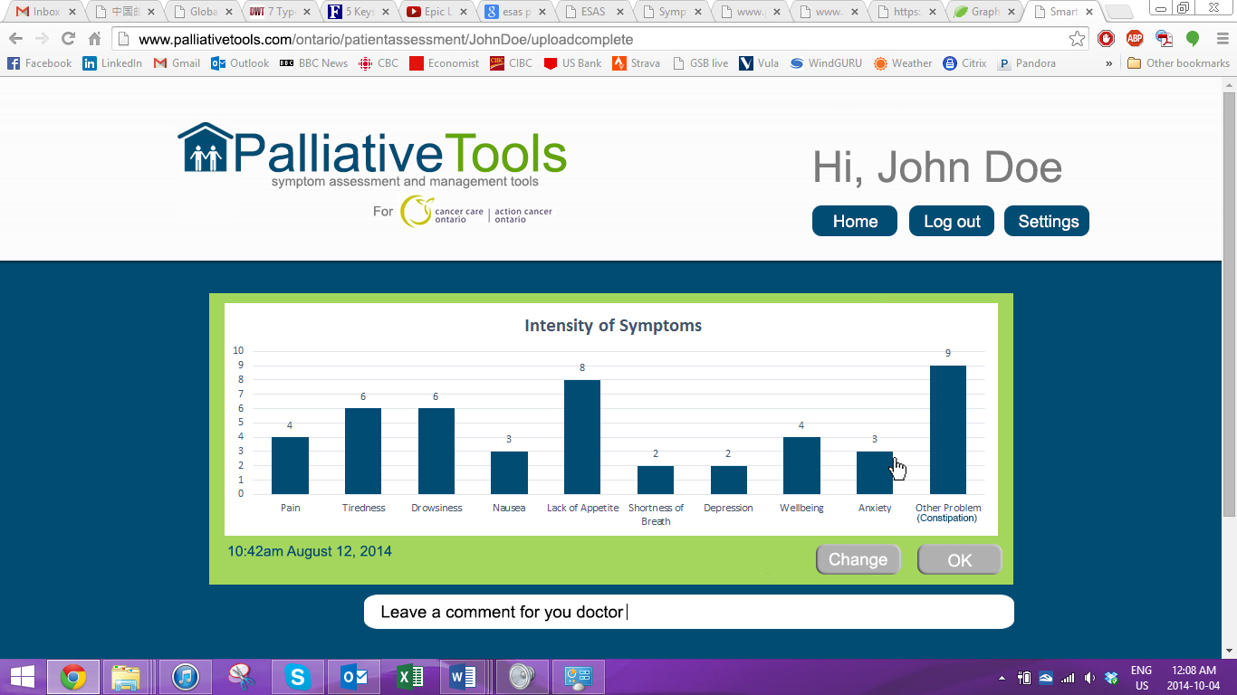

Slide 9
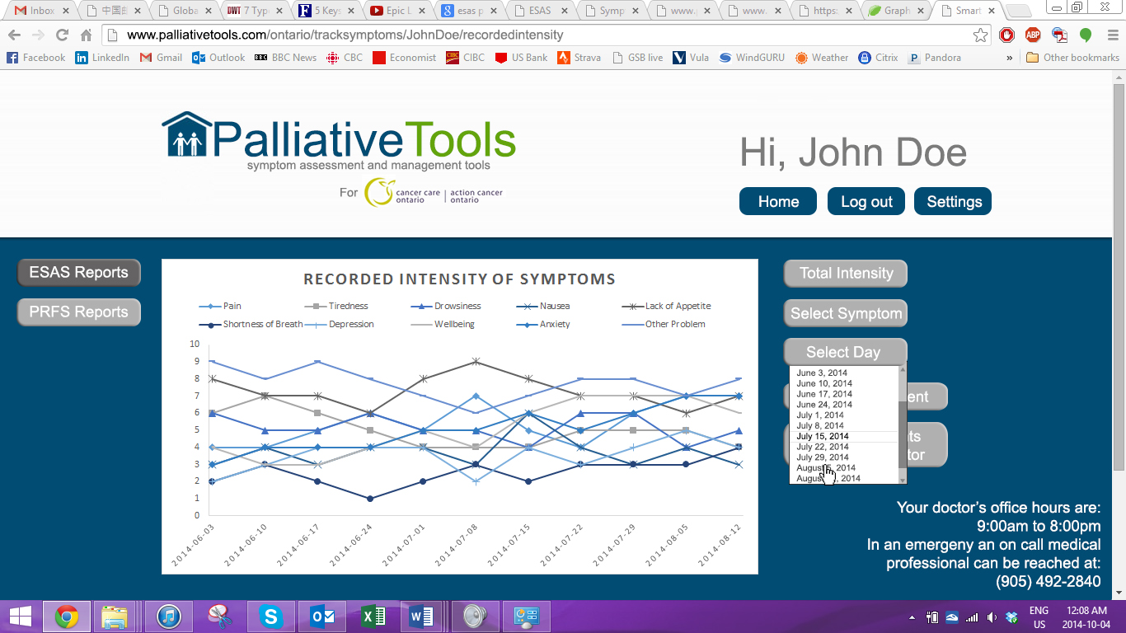

Slide 10
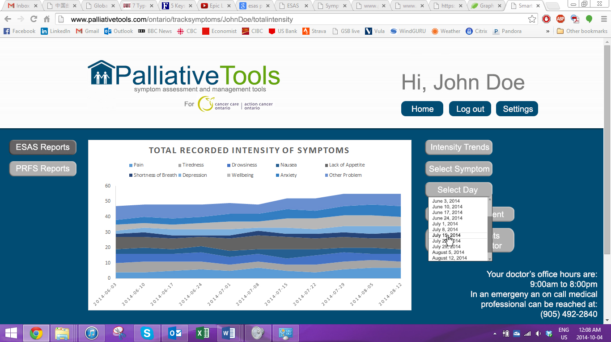

Slide 11
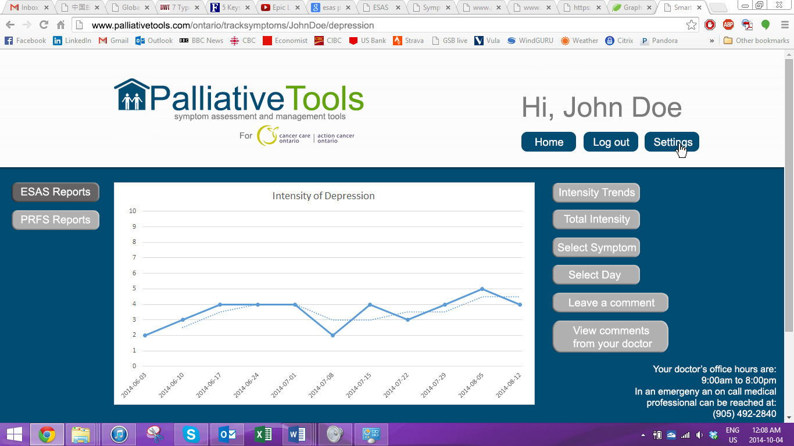

Slide 12
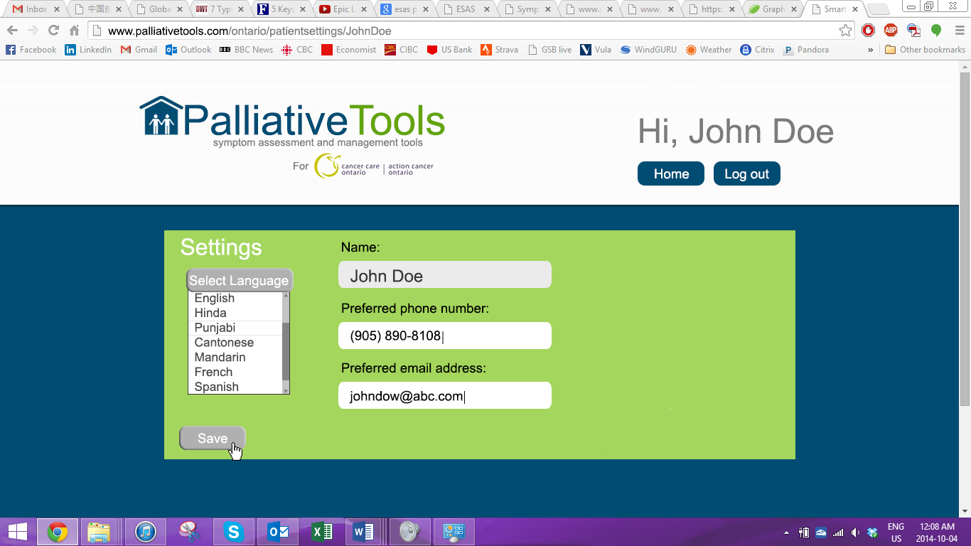

Slide 13
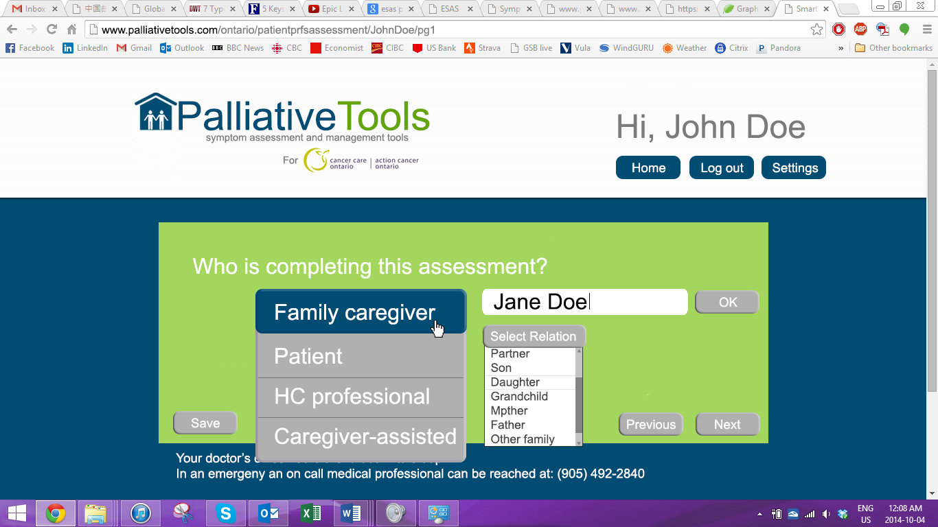

Slide 14
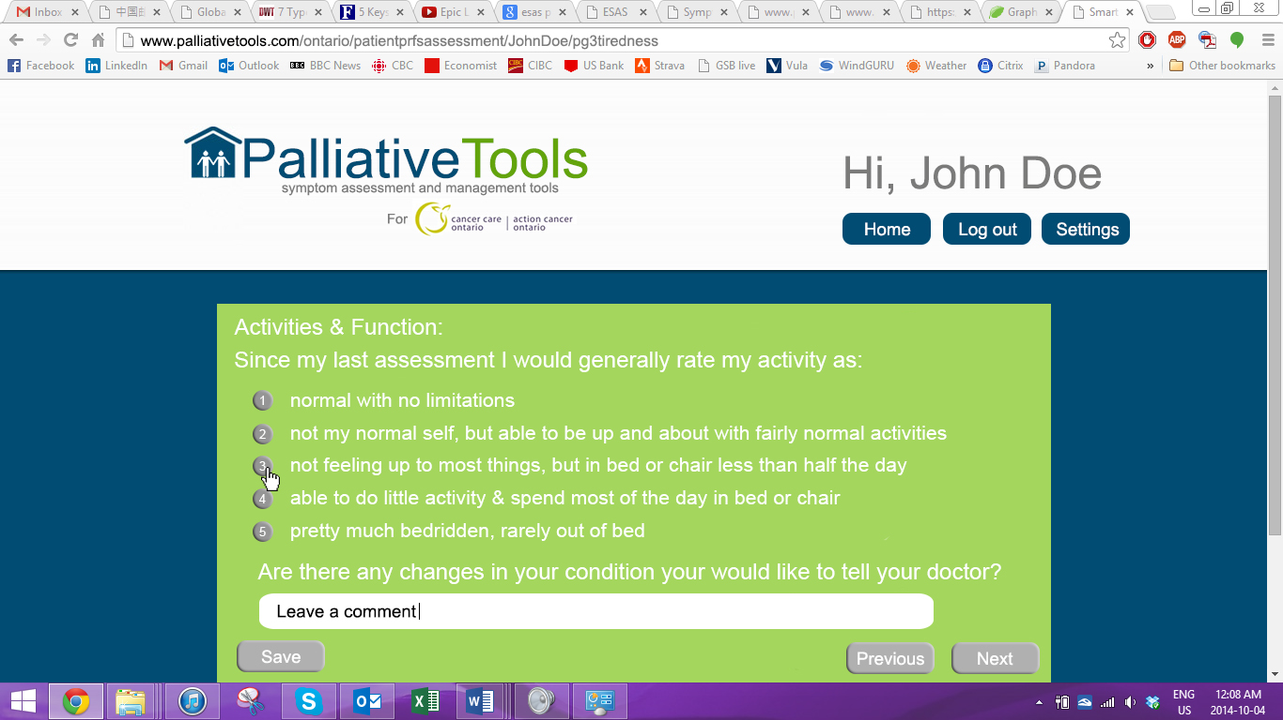

Slide 15
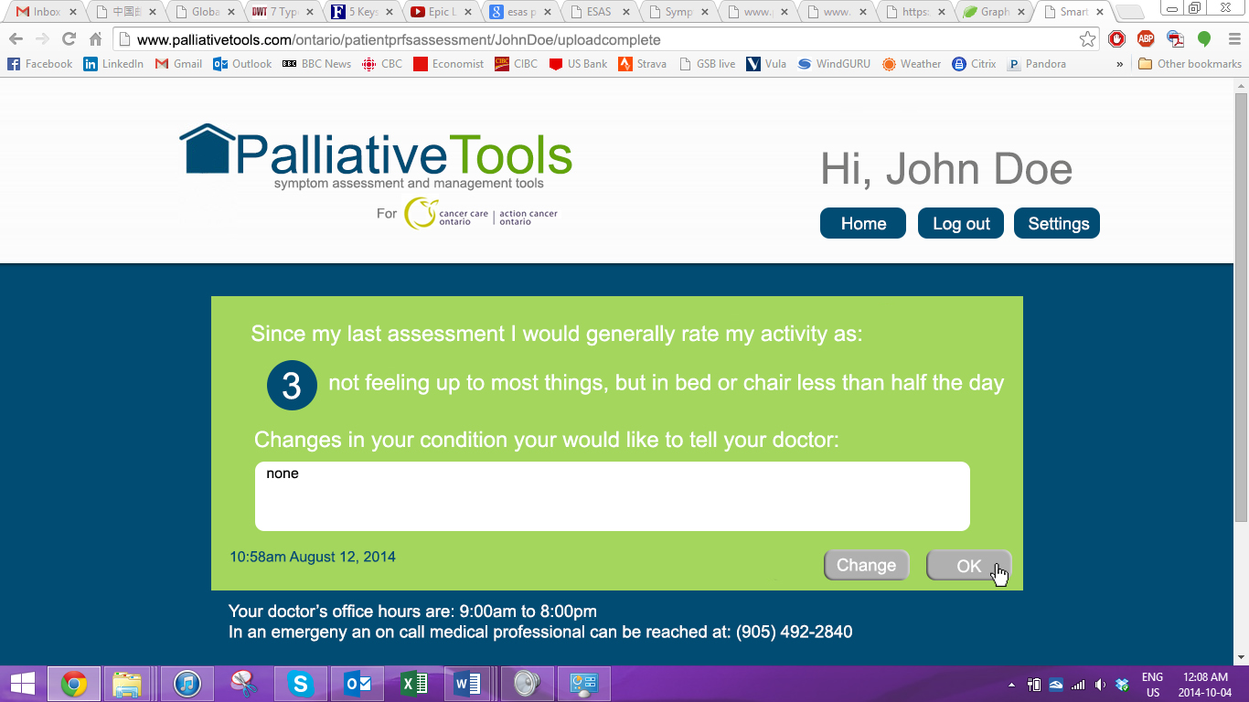

Slide 17
Doctor Process Flow
Login screen
Patient lookup
Add new patient
Home screen HC Professional
Patient archive
Logout
Settings

Slide 18
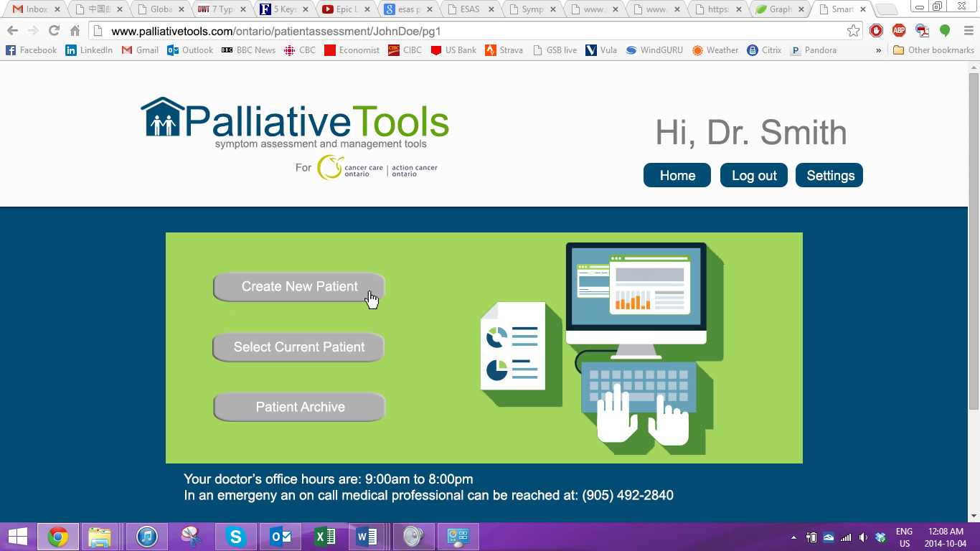

Slide 19
